Slide 1
speech, played several metres from the listener in a room
- seems to have the same phonetic content as when played nearby
- that is, perception is constant
however, amount of reverberation varies with distance:
- so temporal envelopes of speech signals vary considerably,
and these envelopes are crucial for identifying the speech
seems to be an instance of ‘constancy’ (e.g. Watkins & Makin, 2007)
- speech perception ‘takes account’ of reflections’ level:
reverberation in preceding sounds effects a compensation (Watkins, 2005)

Slide 2
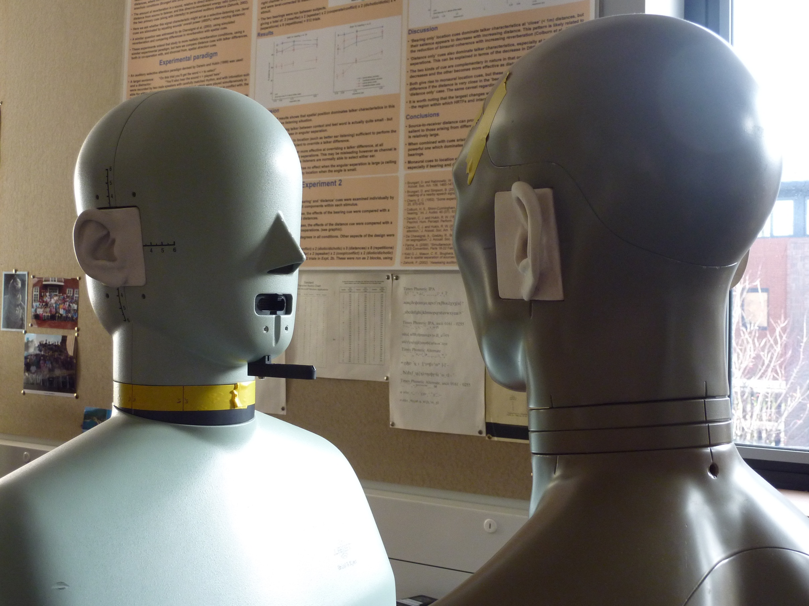
real-room reflection patterns:
- taken from an office room,
volume=183.6 m³
- recorded with dummy-head transducers,
facing each other
room’s impulse response (RIR) obtained at different distances,
- this varies the amount of reflected sound in signals i.e.:
early (50 ms) to late energy ratio: 18 dB at 0.32 m → 2 dB at 10 m,
with an A-weighted energy decay rate of 60 dB per 960 ms at 10 m
RIR convolved with ‘dry’ speech recordings
- headphone presentation → monaural ‘real-room’ listening
speaker
listener

Slide 3
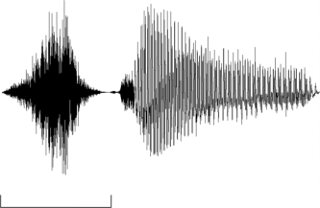
test words; ‘sir’ vs. ‘stir’
distinguished by their temporal envelopes
- notably, the gap (in ‘stir’ ) before voicing onset
11-step continuum:
- end-point ‘stir’ (step 10),
from amplitude modulation of other end-point, ‘sir’ (step 0)
prominent effect of this AM is the gap
intermediate steps, 1-9, by varying modulation depth
AM function
amplitude
‘sir’
‘stir’
step 0
step 10
200 ms
200 ms
time

Slide 4
constancy paradigm
apply RIRs to sounds
- vary their distances
listeners identify these test words
- measure category boundary:
‘extrinsic’ context:
“next you’ll get _ ”
1.
mean category boundary
mean proportion of ‘sir’ responses
.5
0.
0
5
10
“sir”
“stir”
continuum step

Slide 5
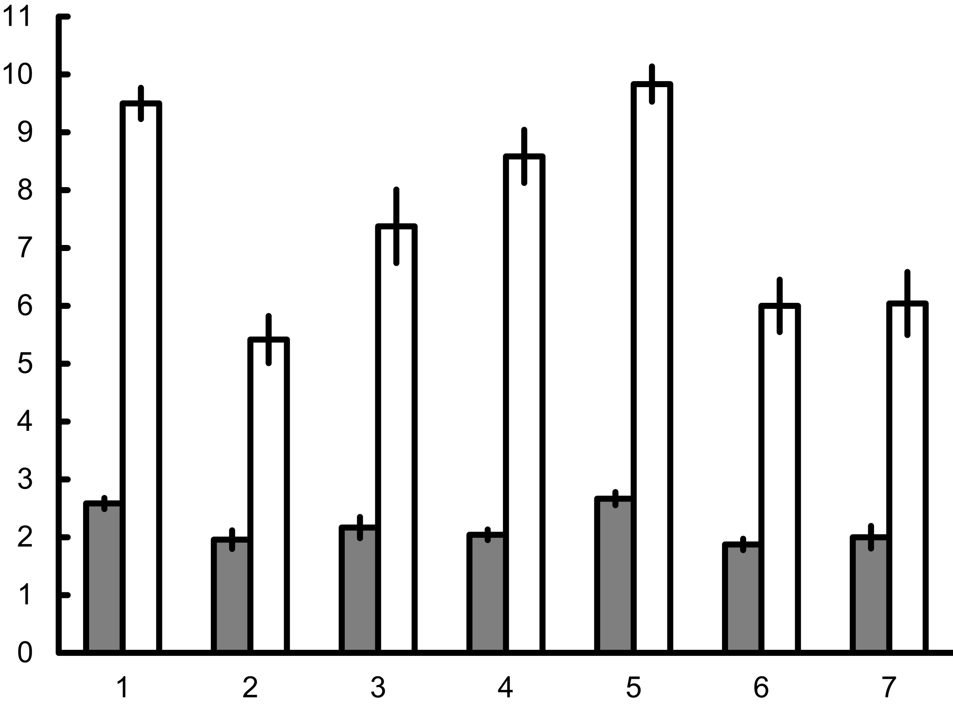
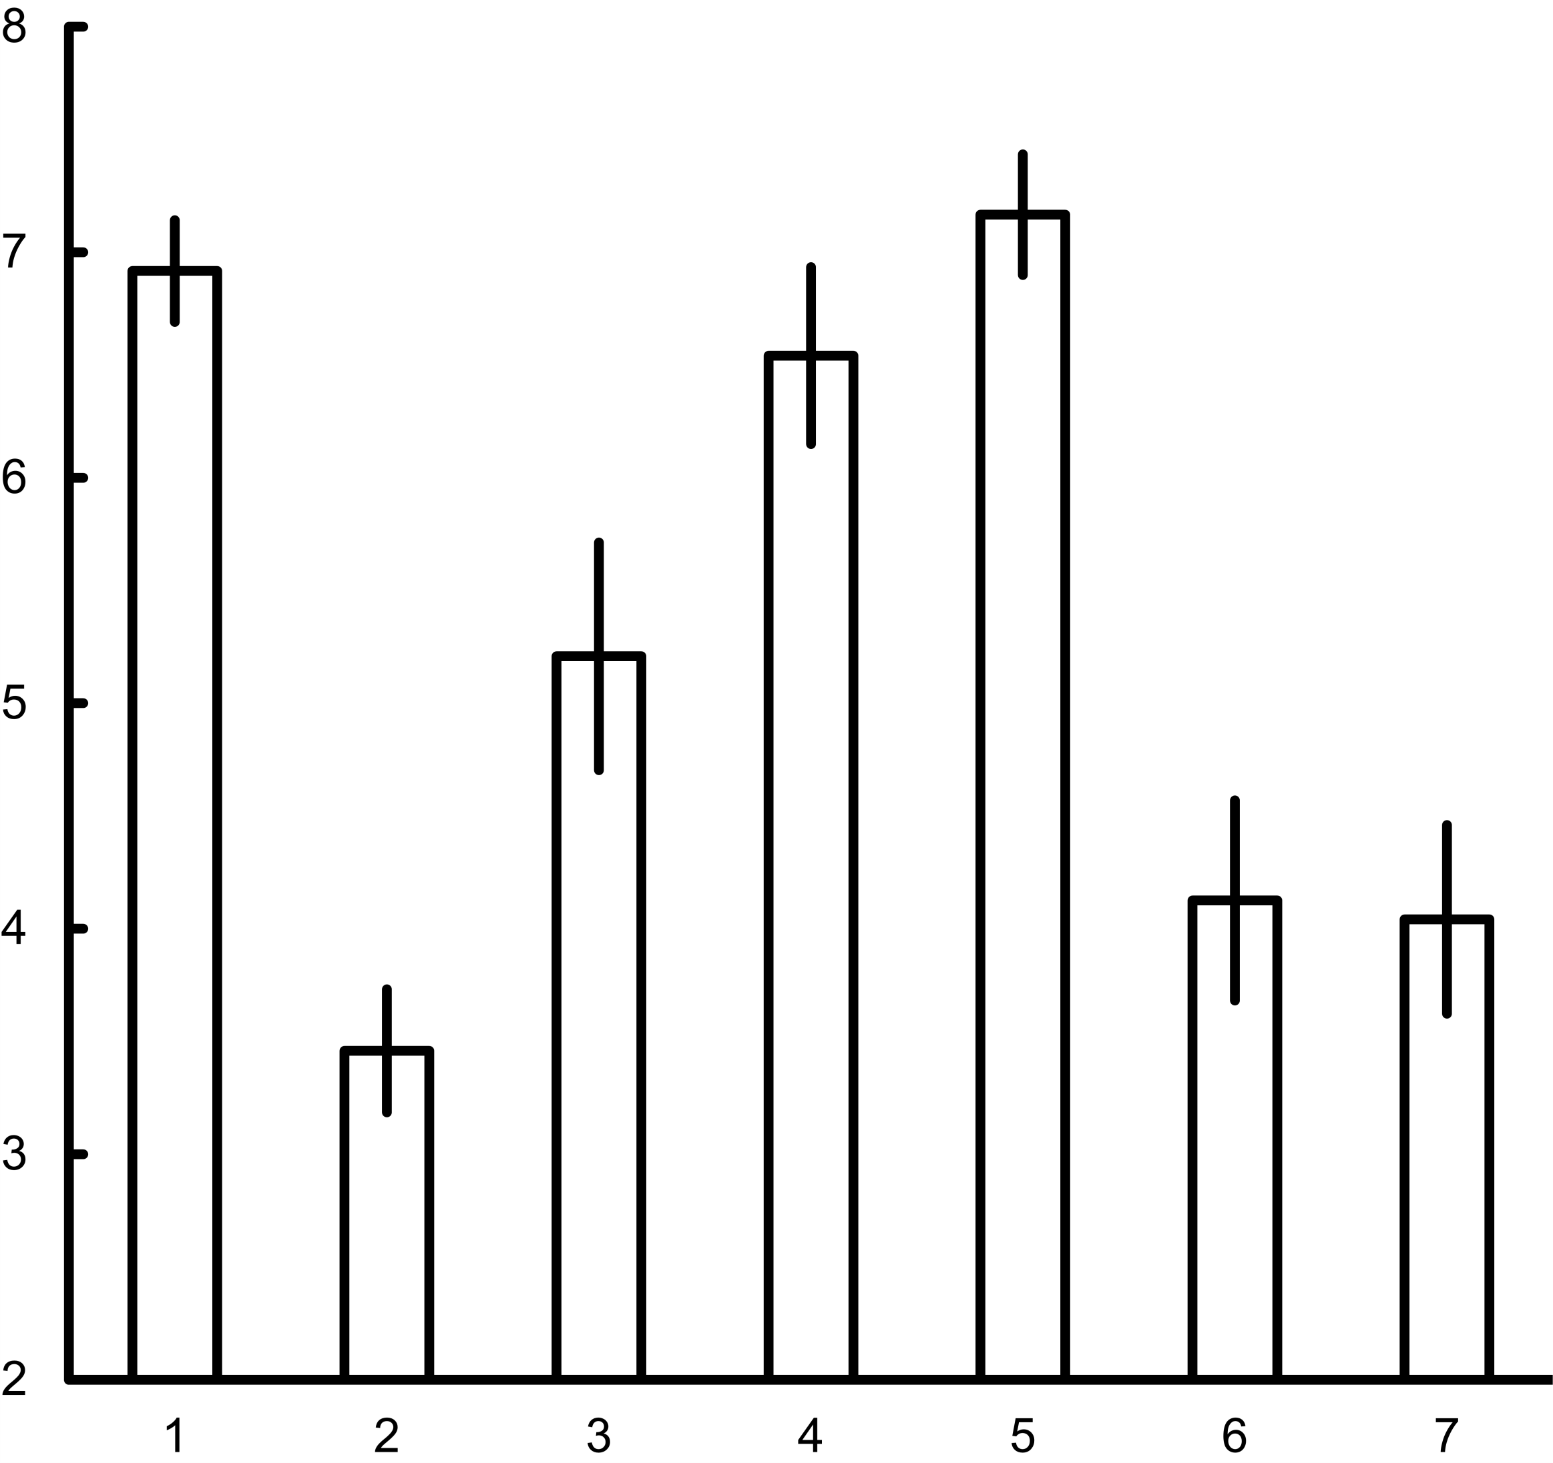
test word
far
8
near
6
category boundary,
step
increase test–word distance:
- more sir responses
- increases category boundary
- substantial far-near difference
increase context’s distance also:
- reduces far-near difference
- more ‘constancy’ of test words
4
2
near
far
none
none
near
far
noise
context
6
test far minus test near,
steps
4
near
far
none
none
near
far
noise
context

Slide 6
test word
far
8
near
6
Nielsen & Dau (2010):
- noise context
- speech-shaped, un-modulated
- behaves like a far context
- similar effect here
- why?
idea about modulation masking:
- obscures gap [t] in ‘stir’
- increases ‘sir’ responses
- mainly from the near contexts,
where there’s more modulation
- mostly affects far test-words
less modulation masking from:
- noise contexts
- and from far contexts,
hence, ‘constancy’ effect
category boundary,
step
4
2
near
far
none
none
near
far
noise
context
6
test far minus test near,
steps
4
near
far
none
none
near
far
noise
context

Slide 7
test word
far
8
near
6
modulation masking → prediction:
- no context
- even less masking
- even smaller far-near difference
opposite here, so effect is:
- compensation from far context
- not masking from near context
constancy informed by context:
- cue is ‘tails’ that reverb. adds
at offsets
near contexts have sharp offsets
- clearly, no tails from reverb.
other contexts; far, noise:
- no sharp offsets;
- presence of tails more likely
category boundary,
step
4
2
near
far
none
none
near
far
noise
context
6
test far minus test near,
steps
4
near
far
none
none
near
far
noise
context

Slide 8
test word
far
8
near
6
context effects are ‘extrinsic’
- are there any intrinsic effects?
i.e., from within the test word
‘gating’;
- removes tail from reverb.,
at end of test-word’s vowel
category boundary,
step
4
2
near
far
none
none
near
far
noise
context
6
test far minus test near,
steps
4
near
far
none
none
near
far
noise
context

Slide 9
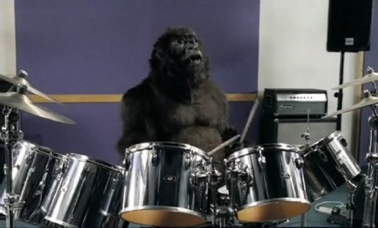
1980s drum sound:
- ‘gated reverb.’
- reduces distance info.
drums → ‘foreground’

Slide 10
‘sir’, near
8
6
frequency, kHz
4
2
200 ms
time

Slide 11
8
near → far,
adds tails
6
frequency, kHz
4
2
200 ms
time

Slide 12
8
far → gated,
cuts tails
6
frequency, kHz
4
2
200 ms
time

Slide 13
test word
}
far
gated
8
near
6
constancy;
- is reduced by gating, so:
- it’s also informed by intrinsic info.,
that arrives after the consonant
w/ extrinsic contexts
- effects of gating not so apparent
competition;
extrinsic > intrinsic
category boundary,
step
4
2
near
far
none
none
near
far
noise
context
6
test far minus test near,
steps
4
near
far
none
none
near
far
noise
context

Slide 14
test word
}
far
gated
8
near
6
Nielsen & Dau (2010),
some no-context data
(w/ only the far test words)
- compared with near contexts,
effects of reverb. were reduced.
same pattern here for constancy:
- on removal of extrinsic influence,
intrinsic effect emerges
category boundary,
step
4
2
near
far
none
none
near
far
noise
context
6
test far minus test near,
steps
4
near
far
none
none
near
far
noise
context

Slide 15
constancy is not effected by modulation masking (or ‘adaptation’):
- this is consistent with data on detection of sinusoidal AM
(Wojtczak & Viemeister, 2005; speech mod. frequencies are too low)
- and with ‘extrinsic’ compensation from preceding contexts in speech
(Watkins, 2005; contexts w/ reversed reverb. don’t → compensation)
there is also some ‘intrinsic’ compensation, from within test words
- informed by tails that arise after the test-word’s consonant
- less influential than the extrinsic compensation from preceding contexts,
so its effects only emerge with isolated test-words

Slide 17
harp in
harp out

Slide 18
‘sir’, far; gated
8
6
frequency, kHz
4
2
200 ms

